Slide 1
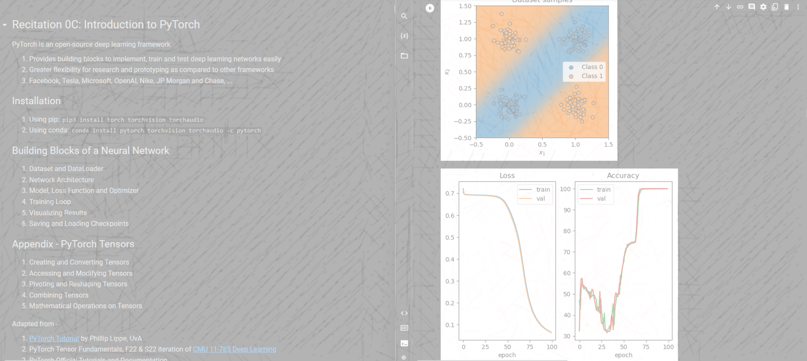


CMU 11785 S23 Recitation 0C
Intro to PyTorch

Slide 2
Building Blocks of a Neural Network
Dataset and Dataloader
Network Architecture
Model, Loss Function and Optimizer
Training Loop
Visualizing Results
Saving and Loading Checkpoints

Slide 3
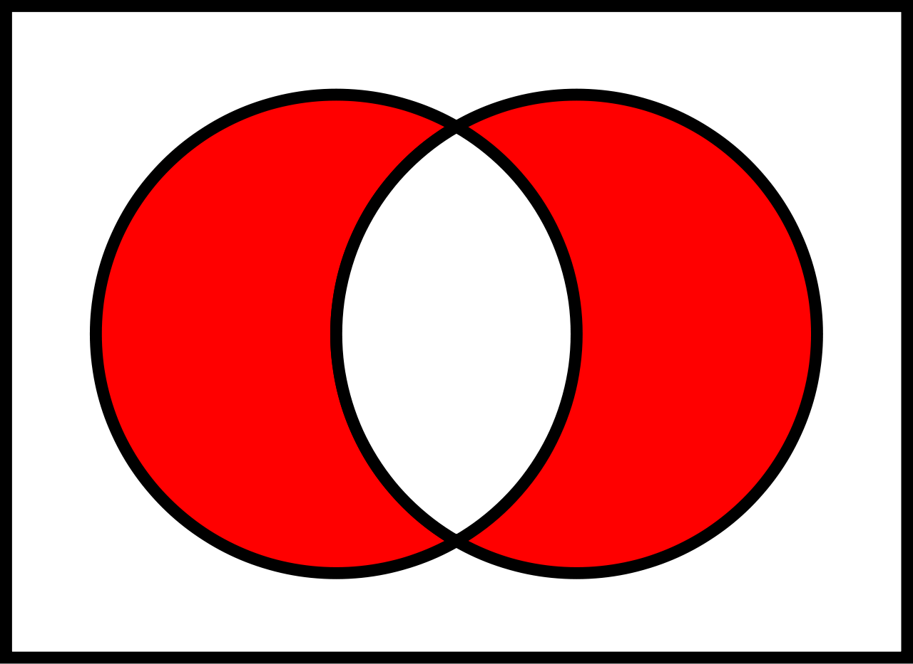
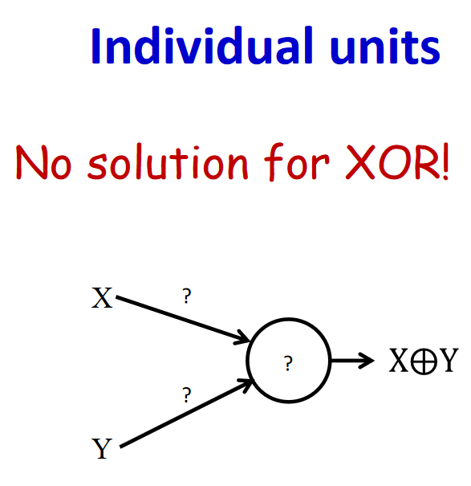
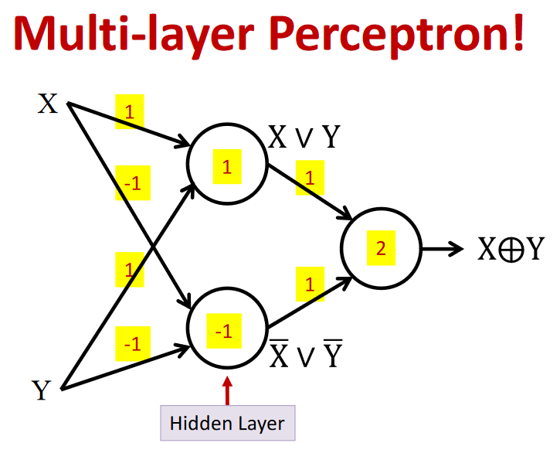
Exclusive OR

Slide 4
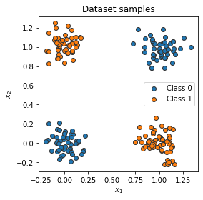
Dataset and Dataloader
Sarthak Bisht (sbisht@andrew.cmu.edu)

Slide 5
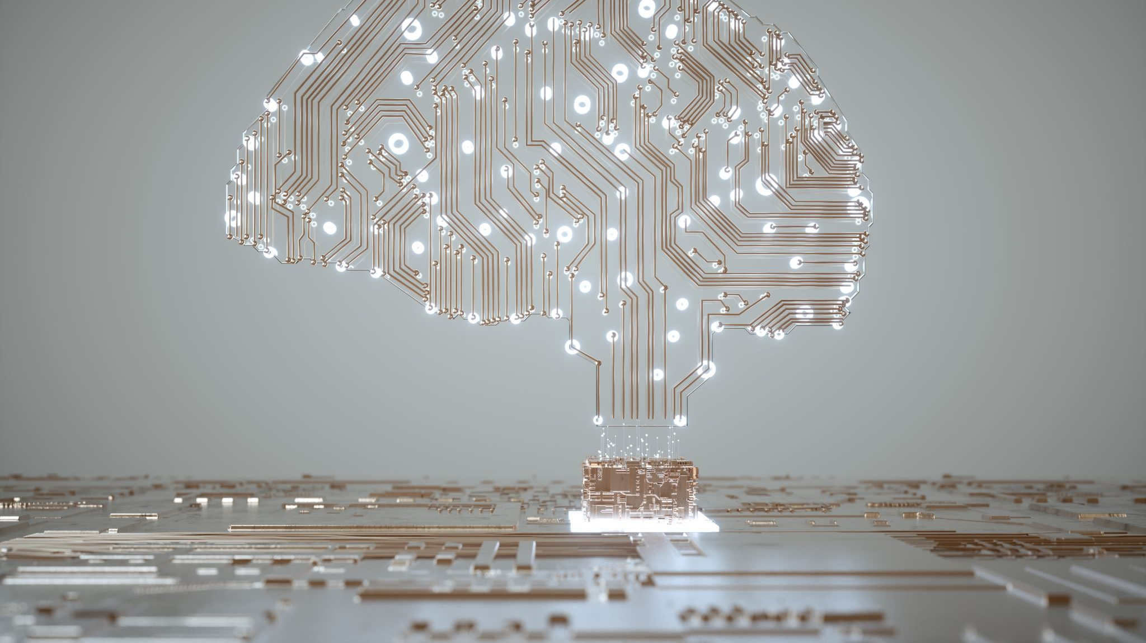
Network Architecture
Sarthak Bisht (sbisht@andrew.cmu.edu)

Slide 6
Exclusive OR

Slide 7

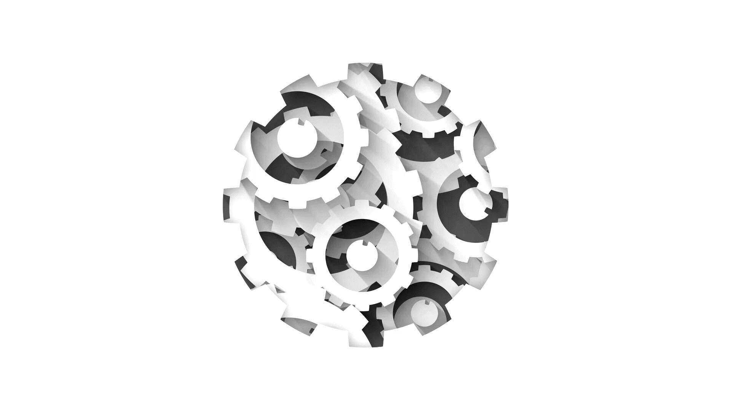
Model, Loss Function and Optimizer
Sarthak Bisht (sbisht@andrew.cmu.edu)

Slide 8

Training Loop
Sarthak Bisht (sbisht@andrew.cmu.edu)

Slide 9
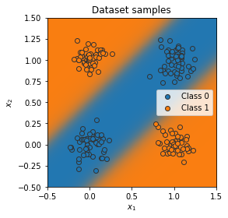
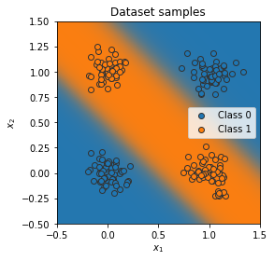
Visualizing Results
Sarthak Bisht (sbisht@andrew.cmu.edu)

Slide 10
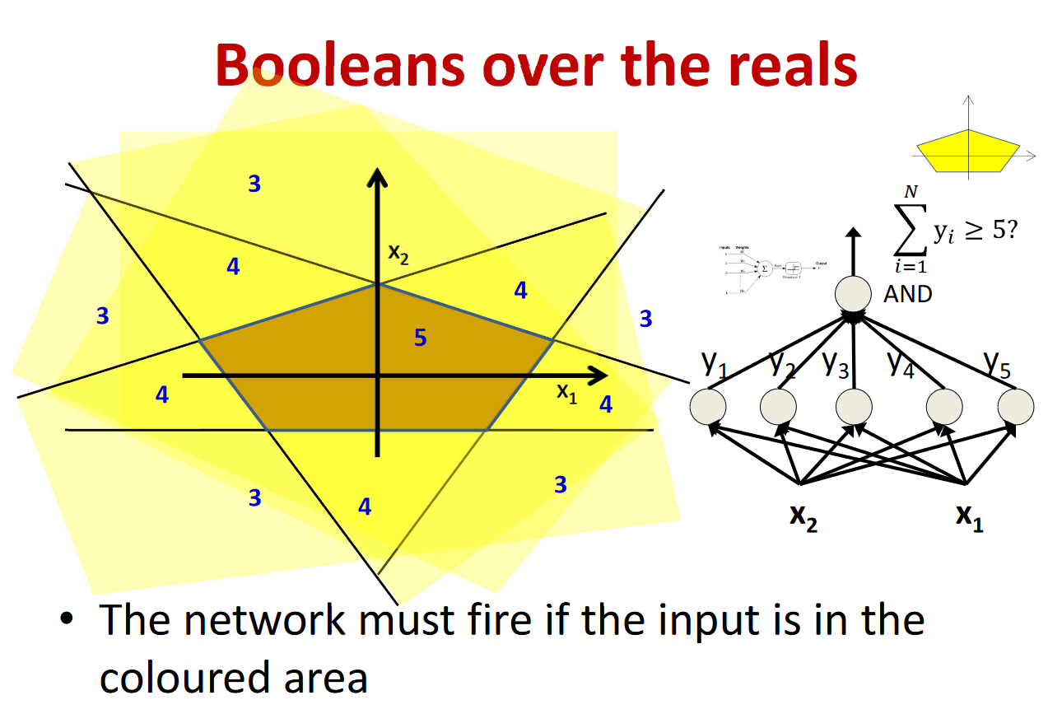

Slide 11

Saving and Loading Checkpoints
Sarthak Bisht (sbisht@andrew.cmu.edu)

